Slide 1
Piedmont Rescue Mission Table Sponsors 2021

Slide 2
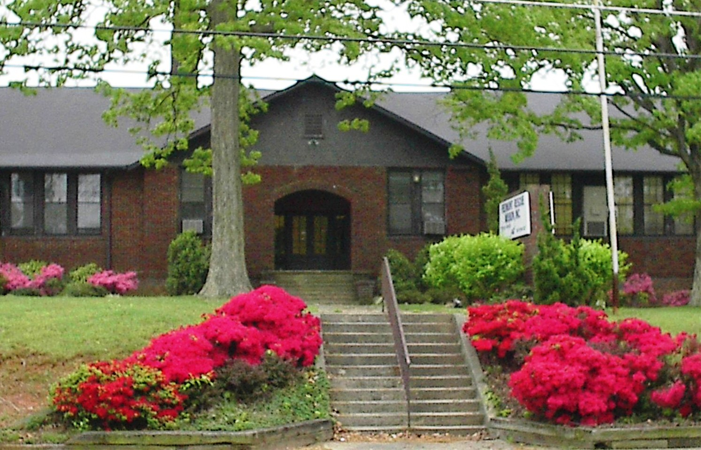
Piedmont Rescue Mission 1982-2021

Slide 3
Baptist Temple

Slide 4
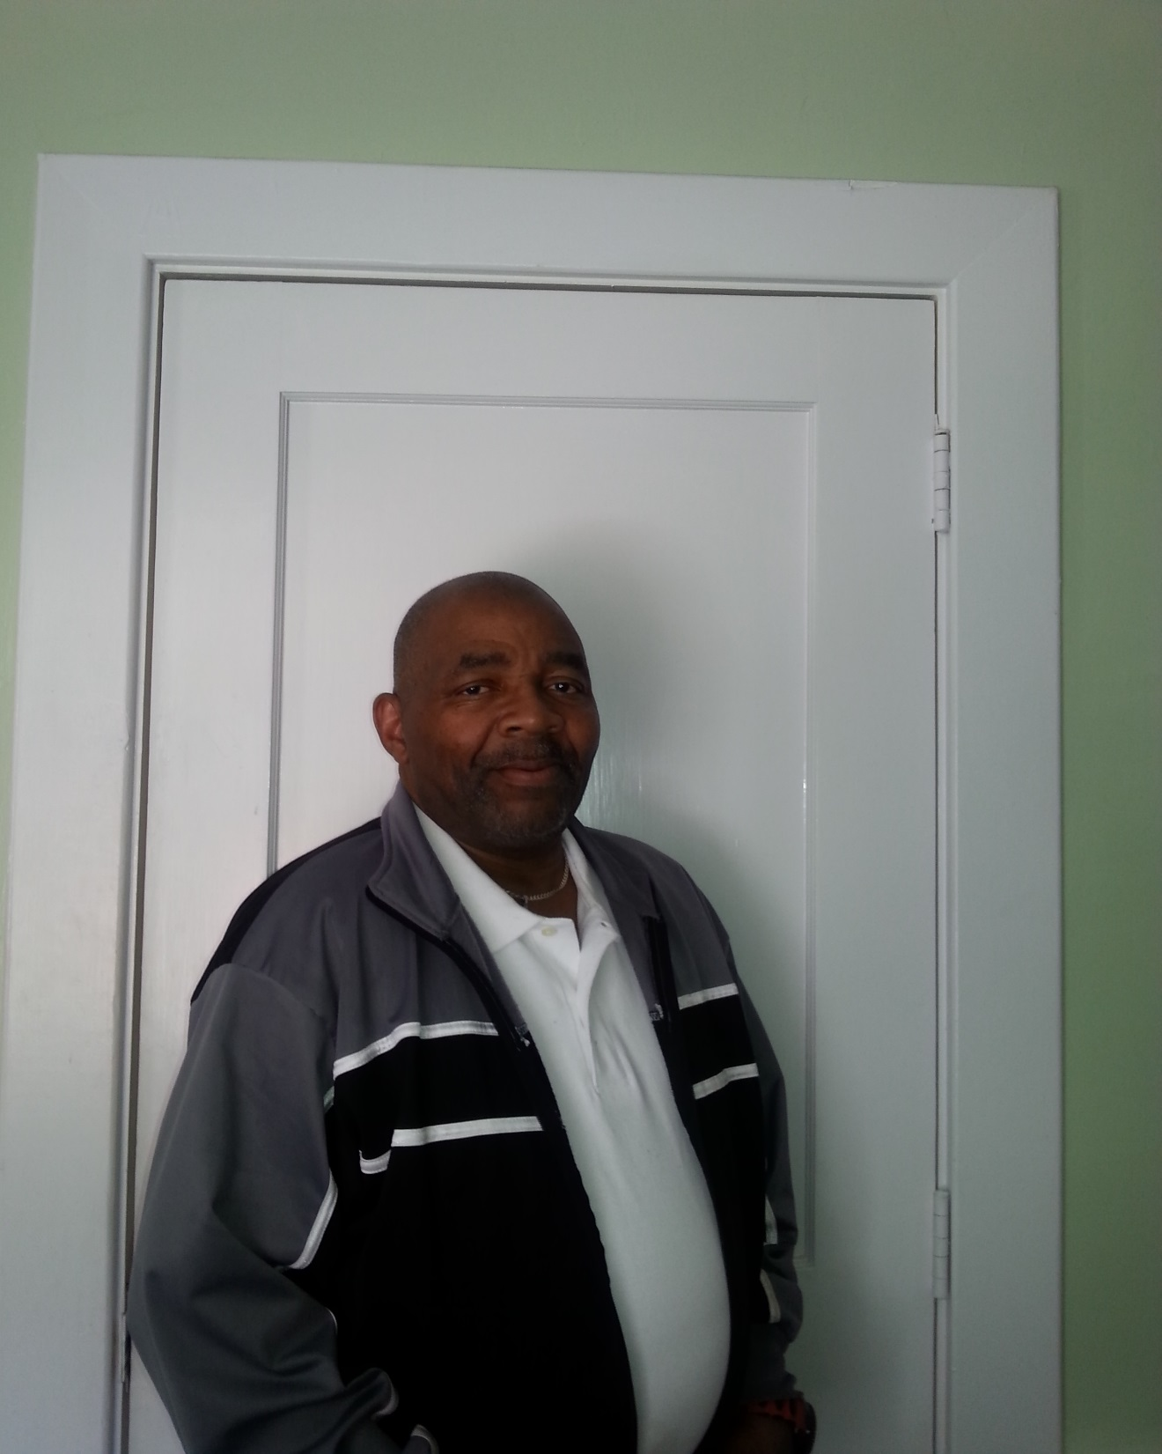
We will miss
Mr. William Green. Please continue to pray for him and his health.

Slide 5
Beacon Baptist Church

Slide 6
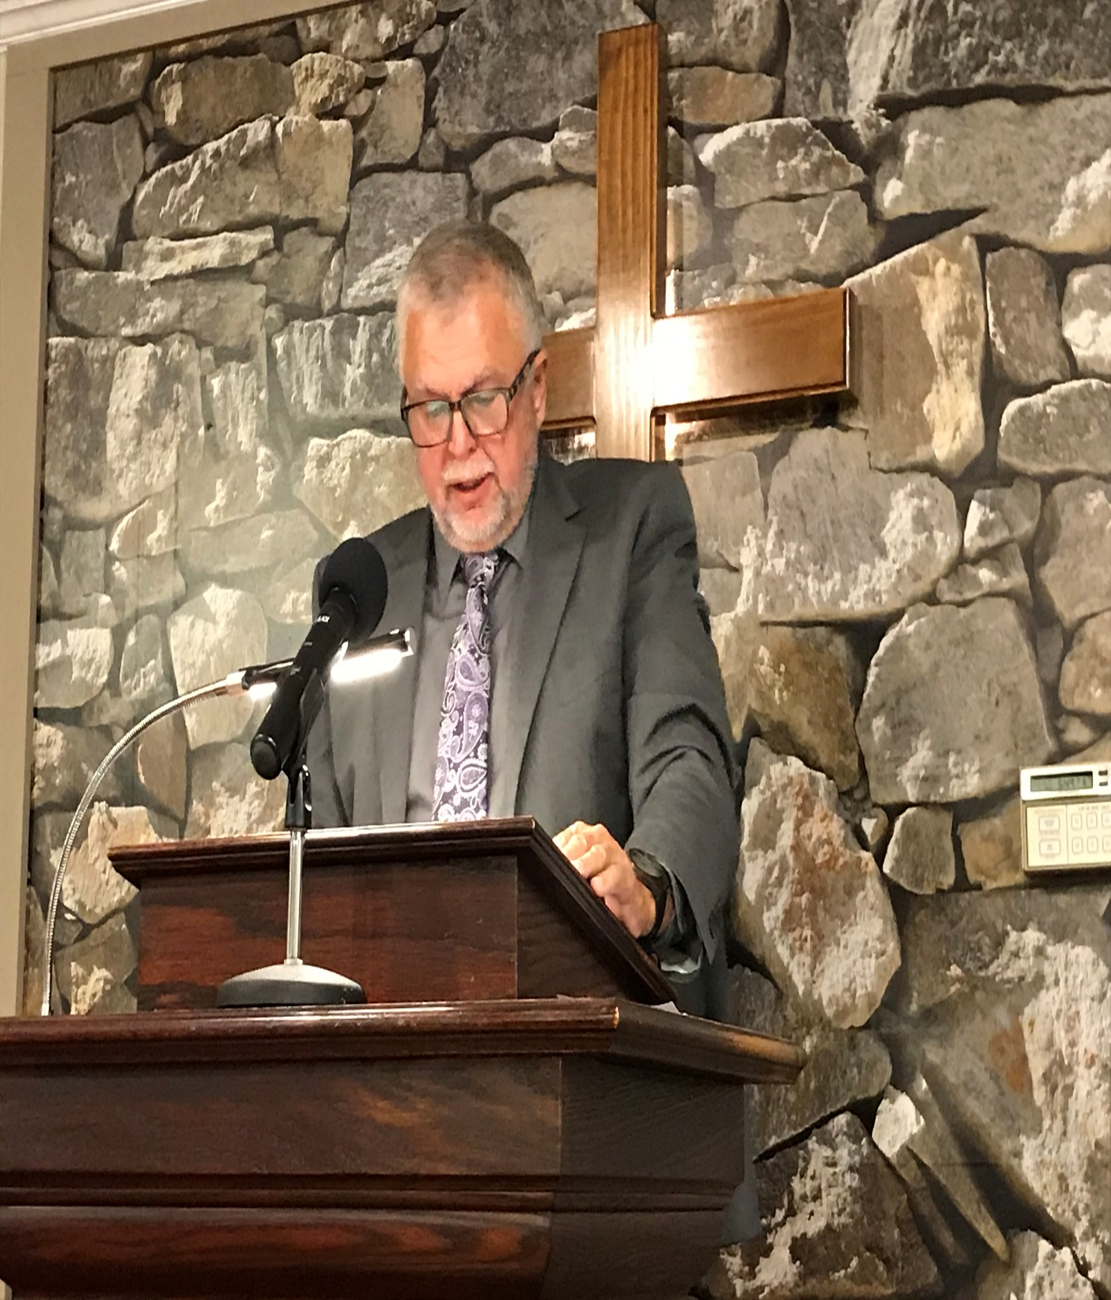
Tony Honeycutt
Executive Director
Piedmont Rescue Mission

Slide 7
Bethel Baptist Church

Slide 8
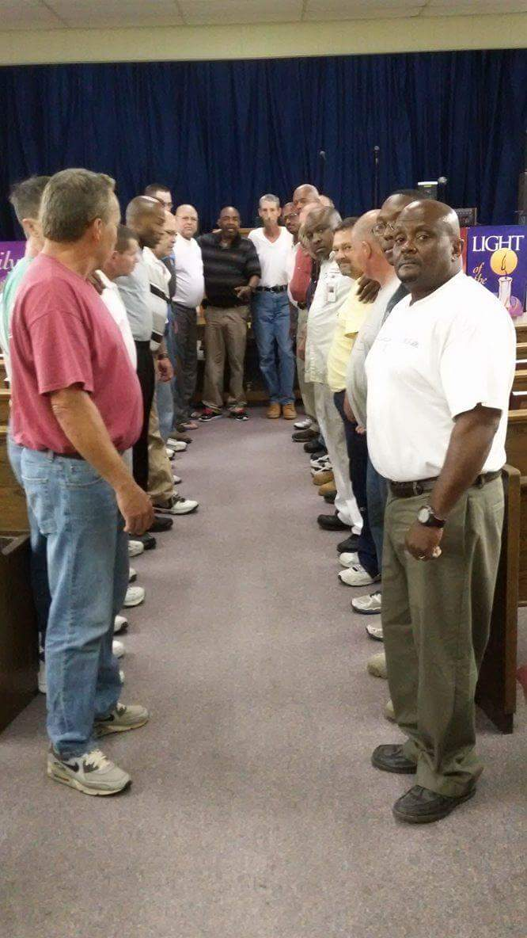
Alamance Rescue Mission
Men’s Intercessory Prayer
Group was started by Mr. William Green, the men continue to hold their prayer meetings even though he is no longer here. What a legacy he left the men here at the mission.

Slide 9
Comtech Network Solutions

Slide 10
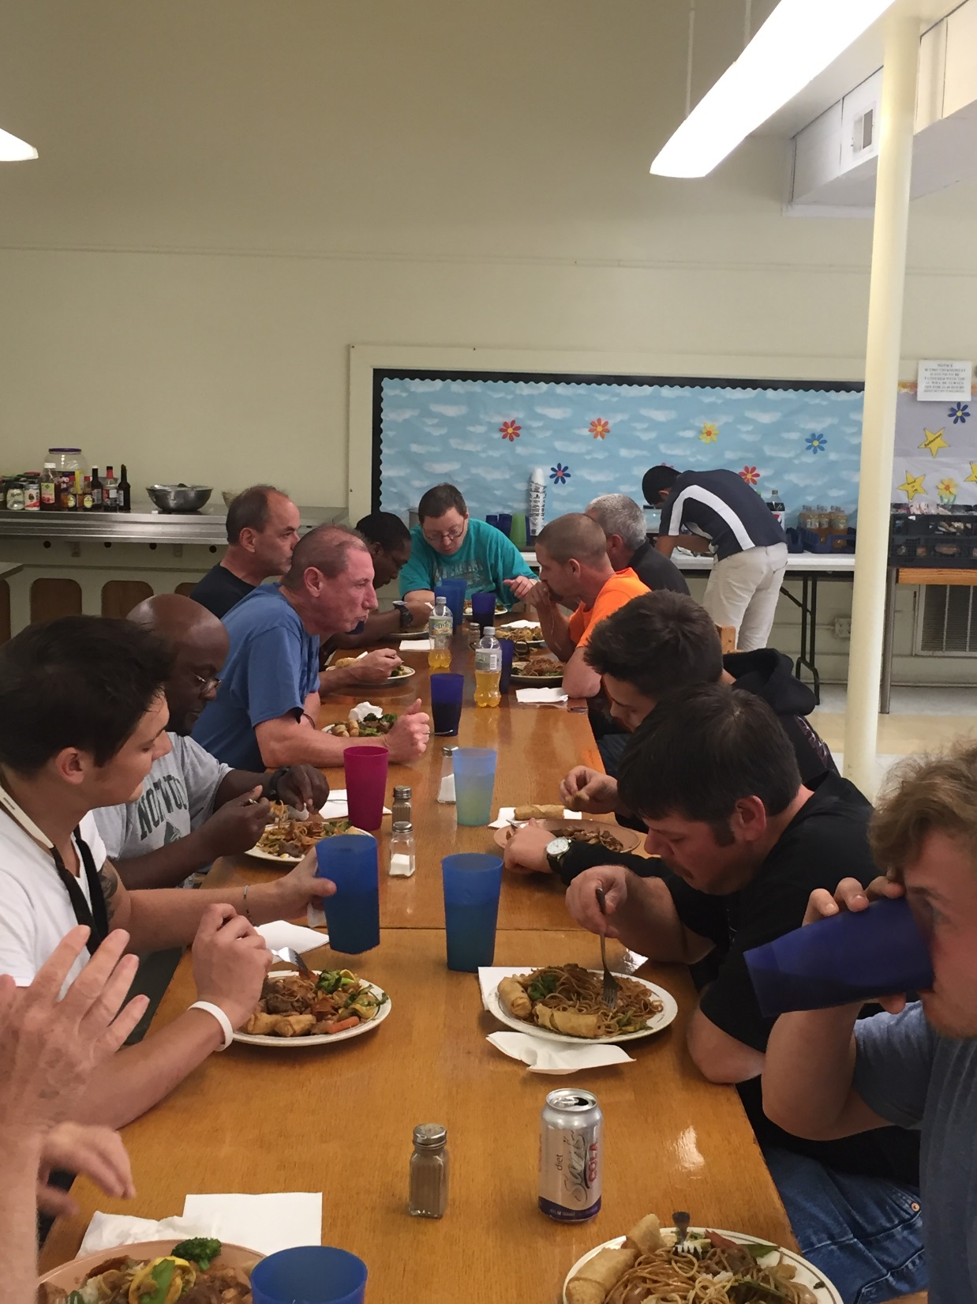
Supper time at the Mission is a time to get to know each other and fellowship.

Slide 11
Crabbe Service Co. Inc.

Slide 12
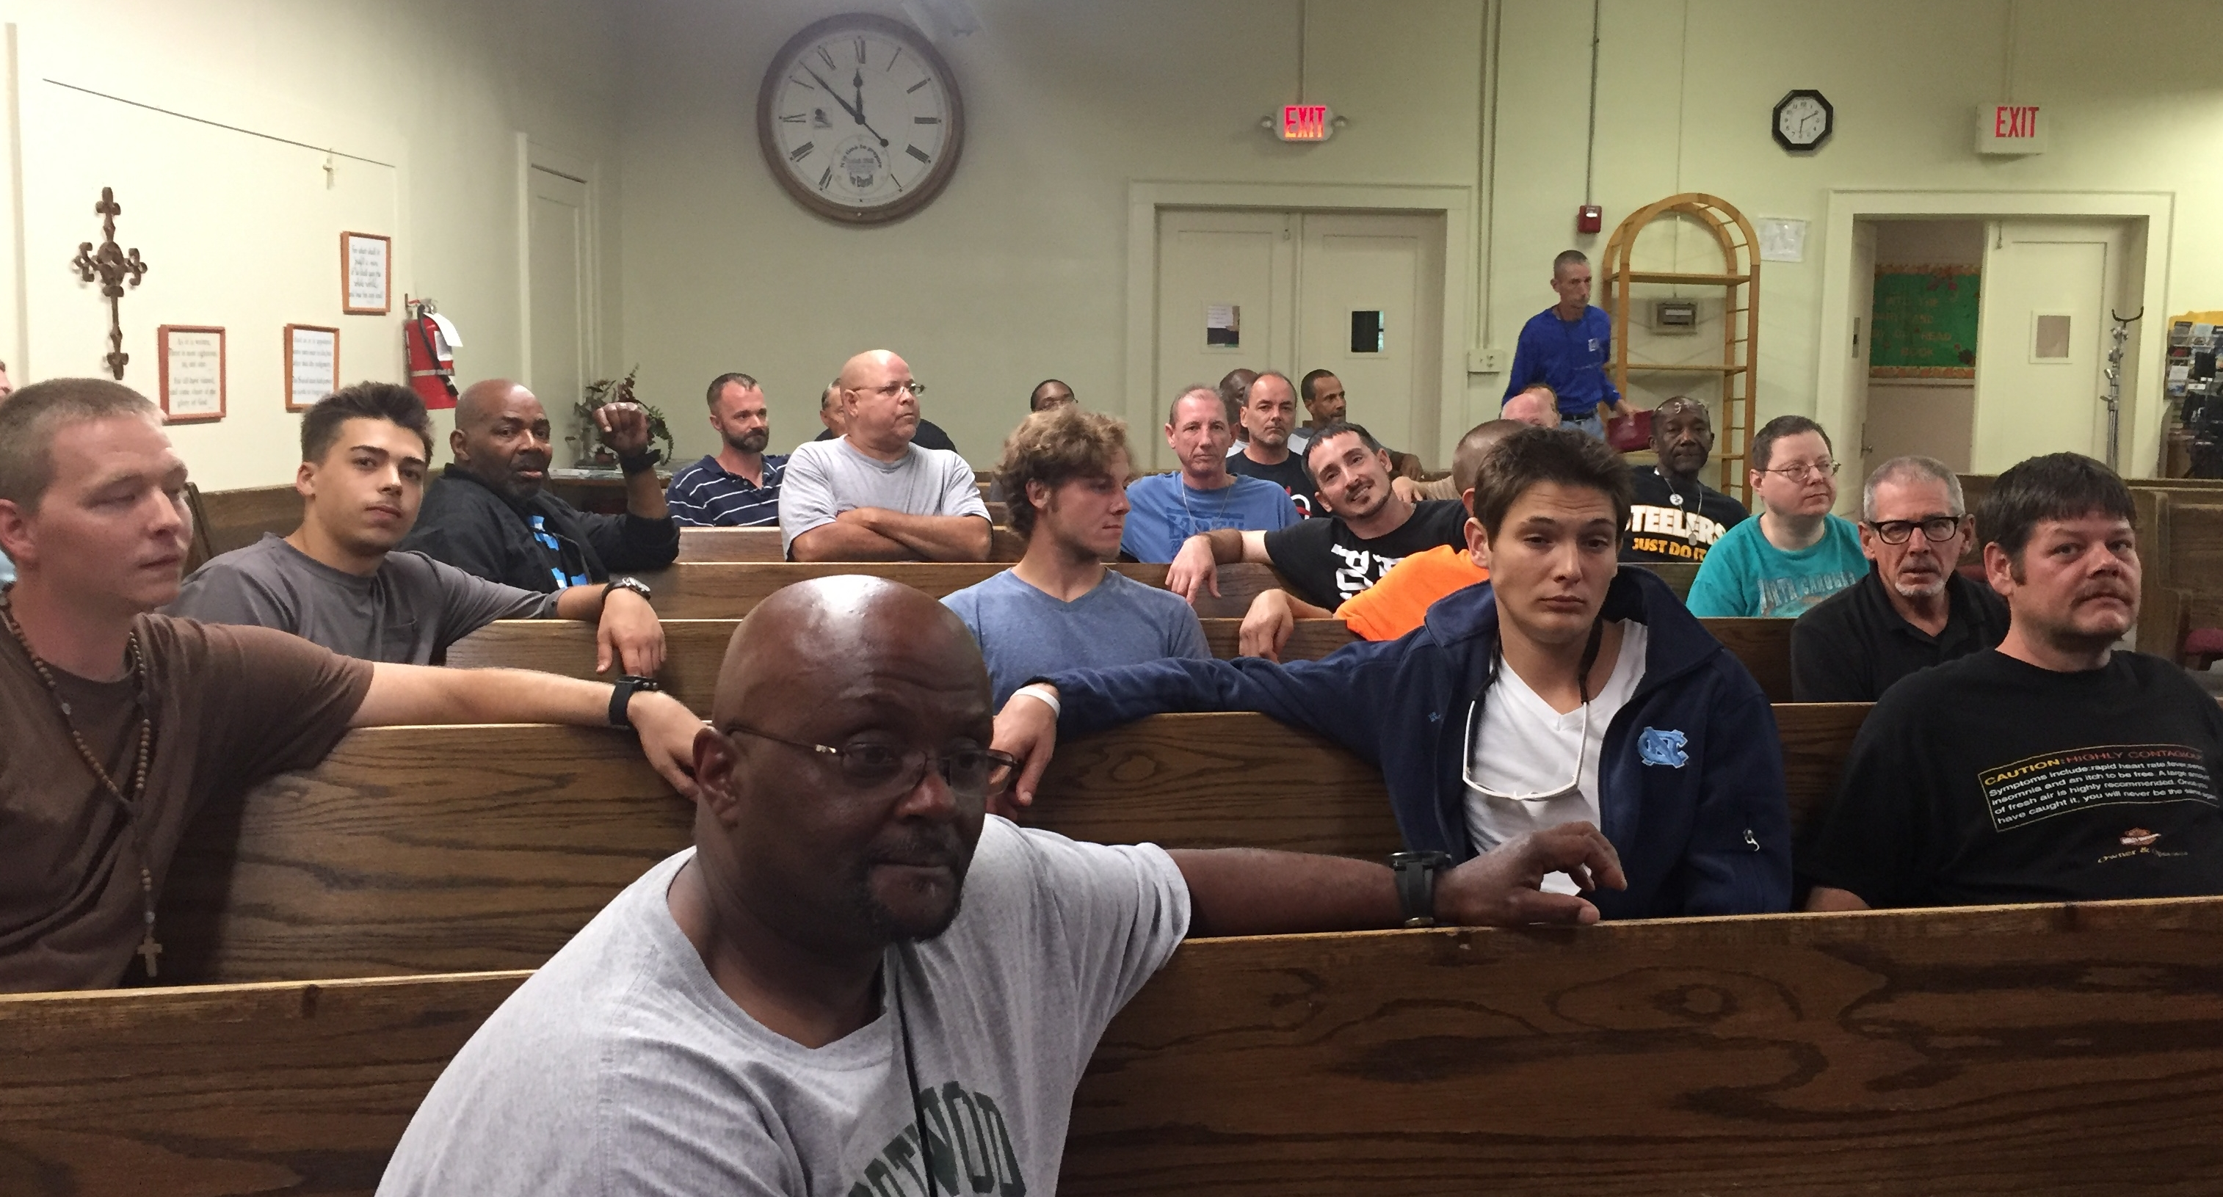
Chapel Services
Monday and Friday evenings after supper is always a special treat for the men.
Pastors and Church groups from the community come out to serve the Lord and to be a testimony to the men here at the mission. We are grateful to all who take of their time to join us in our Chapel Services.

Slide 13
Allen & Kim Eddings
In Memory of
Carl Pecci

Slide 14
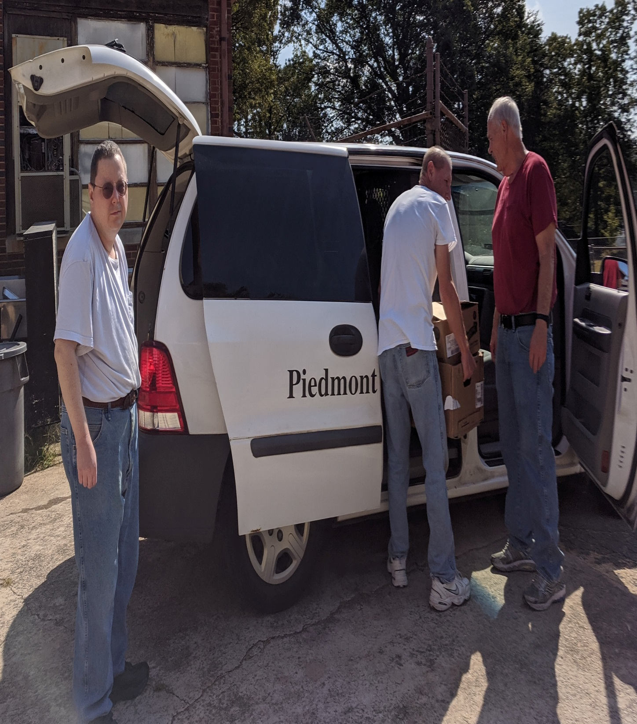
Food Collection and Distribution is another important ministry of Piedmont Rescue Mission.
PRM distributes food to needy in our community two days of the week.

Slide 15
First Associate Reformed Presbyterian

Slide 16
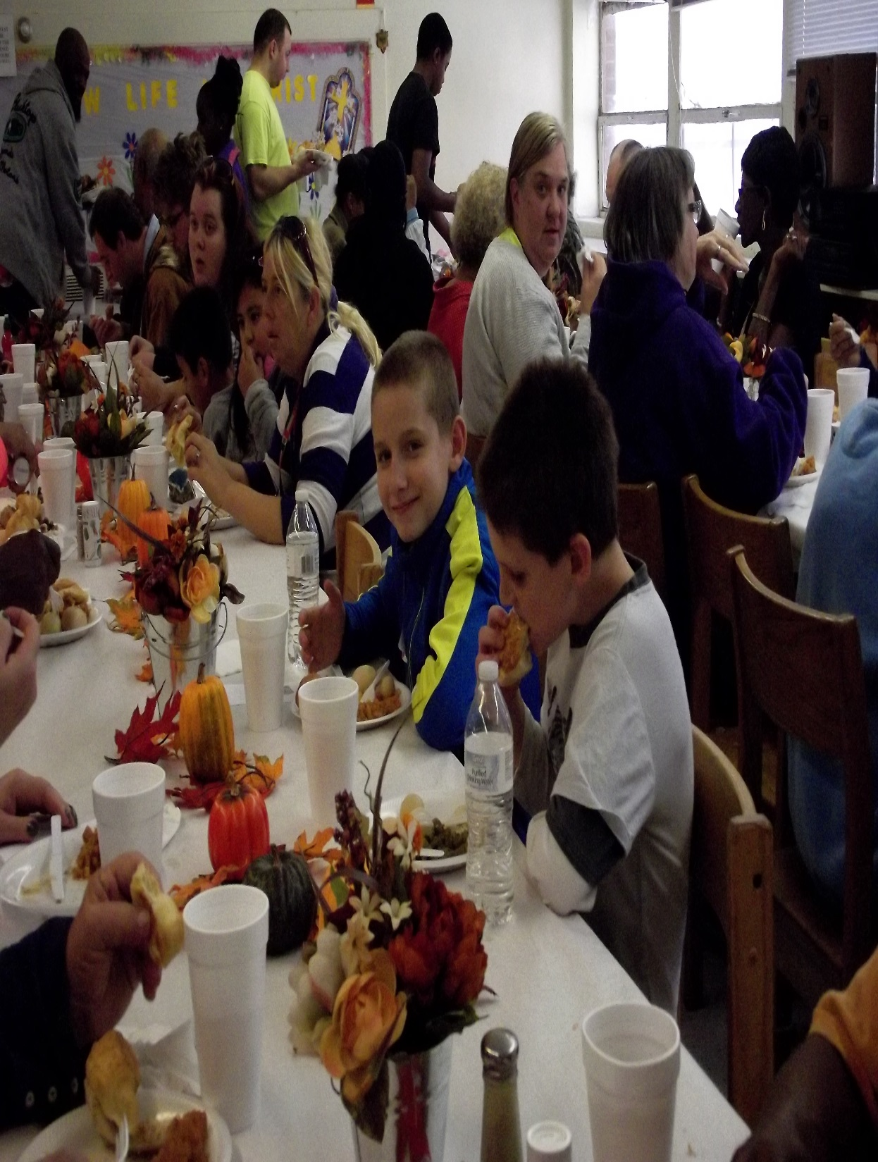
Piedmont Rescue Mission also serves our community Thanksgiving Meals and Christmas Meals. At Christmas we serve approximately 600 people. We give out toys to the children, but most important of all we share the Gospel with everyone that comes to the meal.

Slide 17
First Wesleyan Church

Slide 18
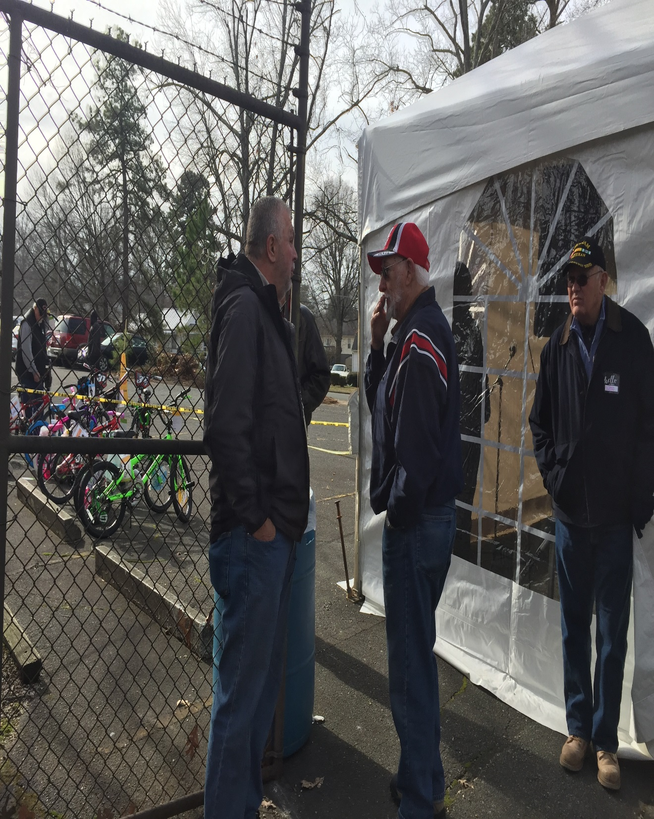
We love fellowshipping with our volunteers that come out to help us during our Thanksgiving and Christmas meals.

Slide 19
Grace Memorial Baptist Church

Slide 20
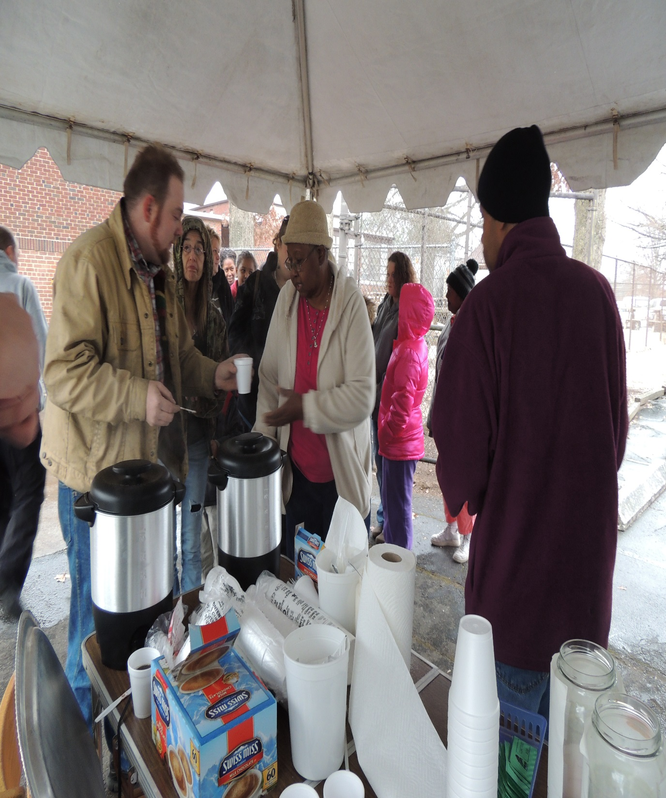
Keeping warm at our Christmas Event with Hot Chocolate and Coffee!

Slide 21
Grace Reformed Baptist

Slide 22
Alamance Pregnancy Services

Slide 23
Graham Friends Church

Slide 24
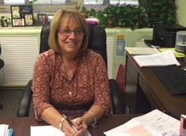
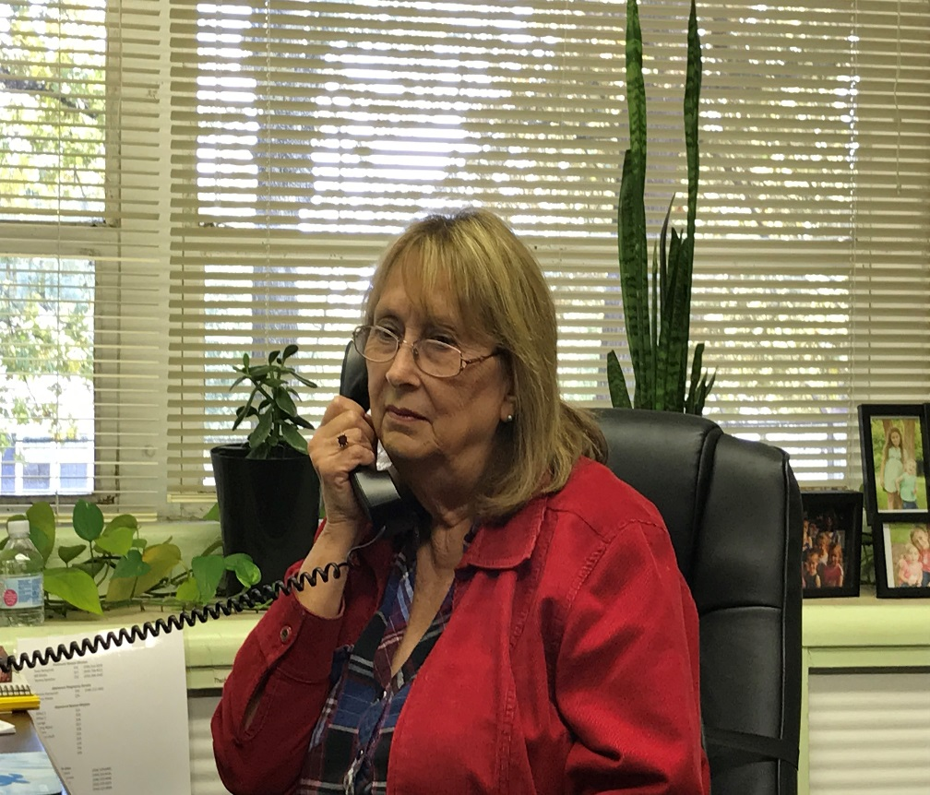
Alamance Pregnancy Services
Counselors
Tammy Honeycutt
and
Jeanne Weeks

Slide 25
Harvest Baptist Church

Slide 26
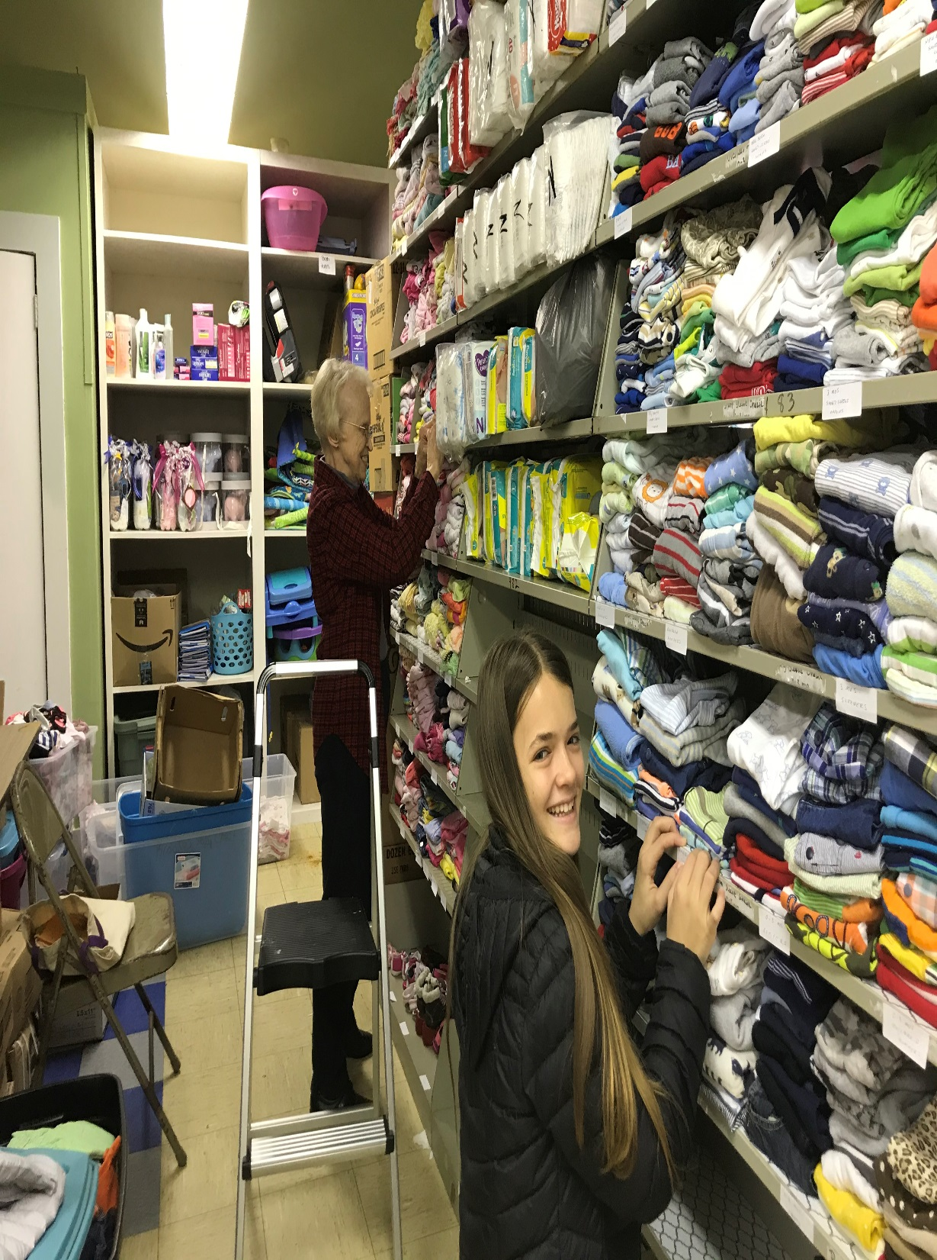
Alamance Pregnancy Services Volunteers
We are so thankful for Mrs. Nita and her granddaughter Suzie for all the hard work they put into keeping the baby storeroom organized.

Slide 27
Heritage Real Estate

Slide 28
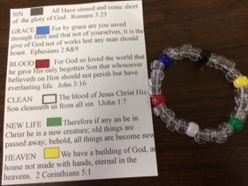
Every lady that comes to our offices for an appointment receive this wordless book bracelet and the gospel! Our main objective here is to make sure no one leaves our office without a gospel message!

Slide 29
Hurlockers Truck & Trailer Repair

Slide 30
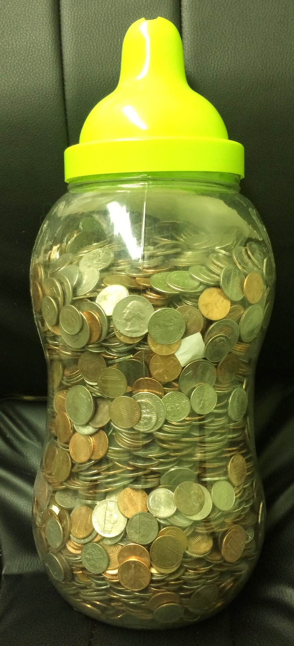
A Great Big Thank
you to all of you who participated in the
Baby Bottle Boomerang
in 2021.
Best Year Ever!!!!

Slide 31
Kernodle Clinic

Slide 32
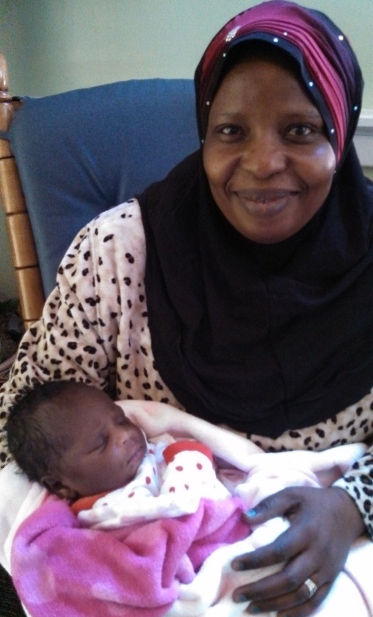
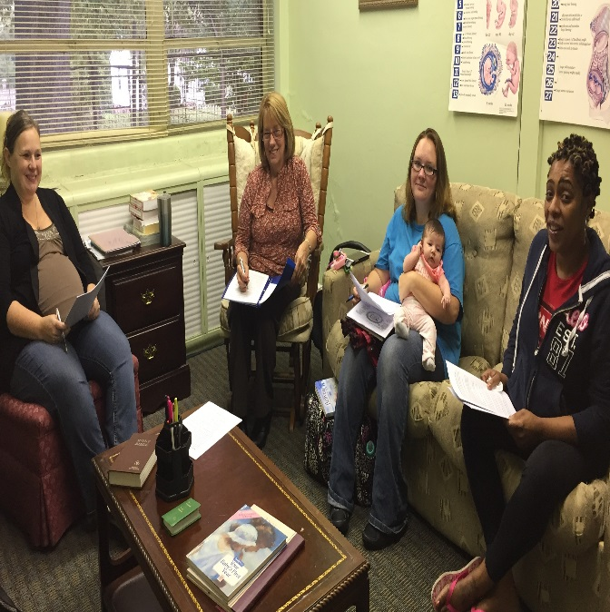
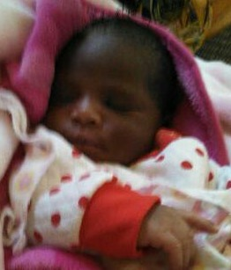
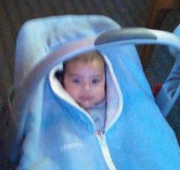
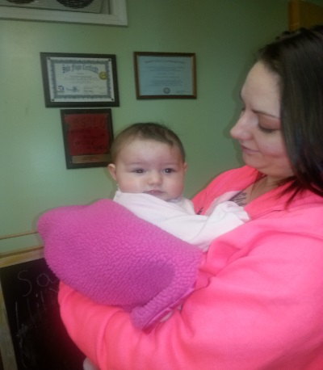
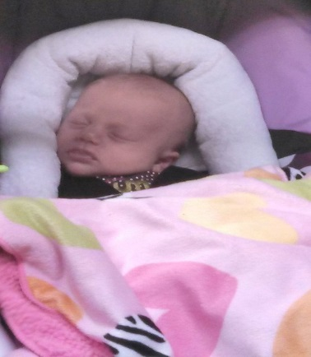
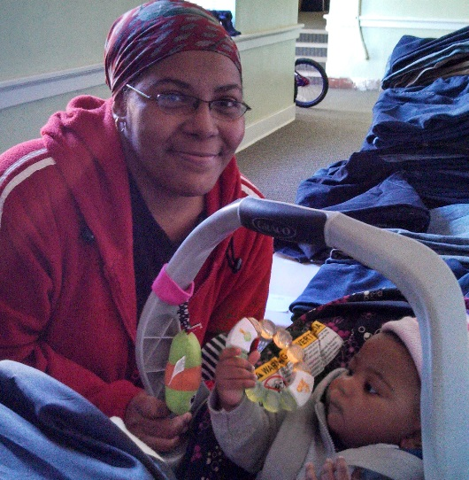
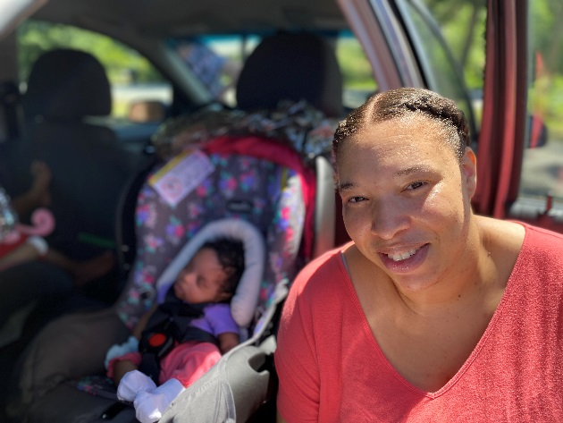
The many faces of
Alamance Pregnancy Services
We love them all
Moms
and
Babies!

Slide 33
Mcleansville Baptist Church

Slide 34
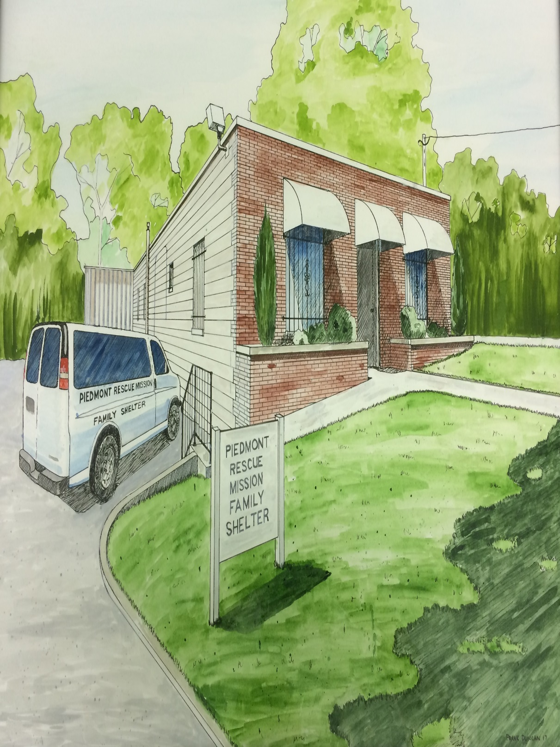
PRM Women and
Children’s Shelter
Thank you to all individuals and groups who have come out and volunteered your service to help us renovate this building.
Please pray for the continued work on this project and that we will soon be able to say, “Yes, we do have a place for women and children.”

Slide 35
Lighthouse Bible Church

Slide 36
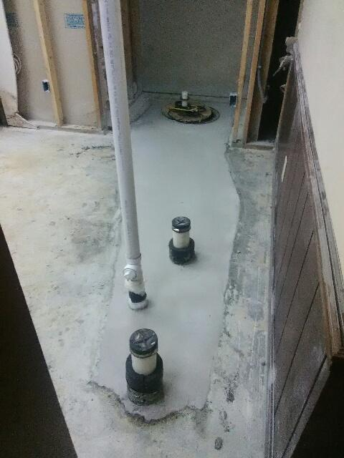
Thank you to the Plumbers and Concrete Workers!

Slide 37
Ernie & Gail Mills

Slide 38
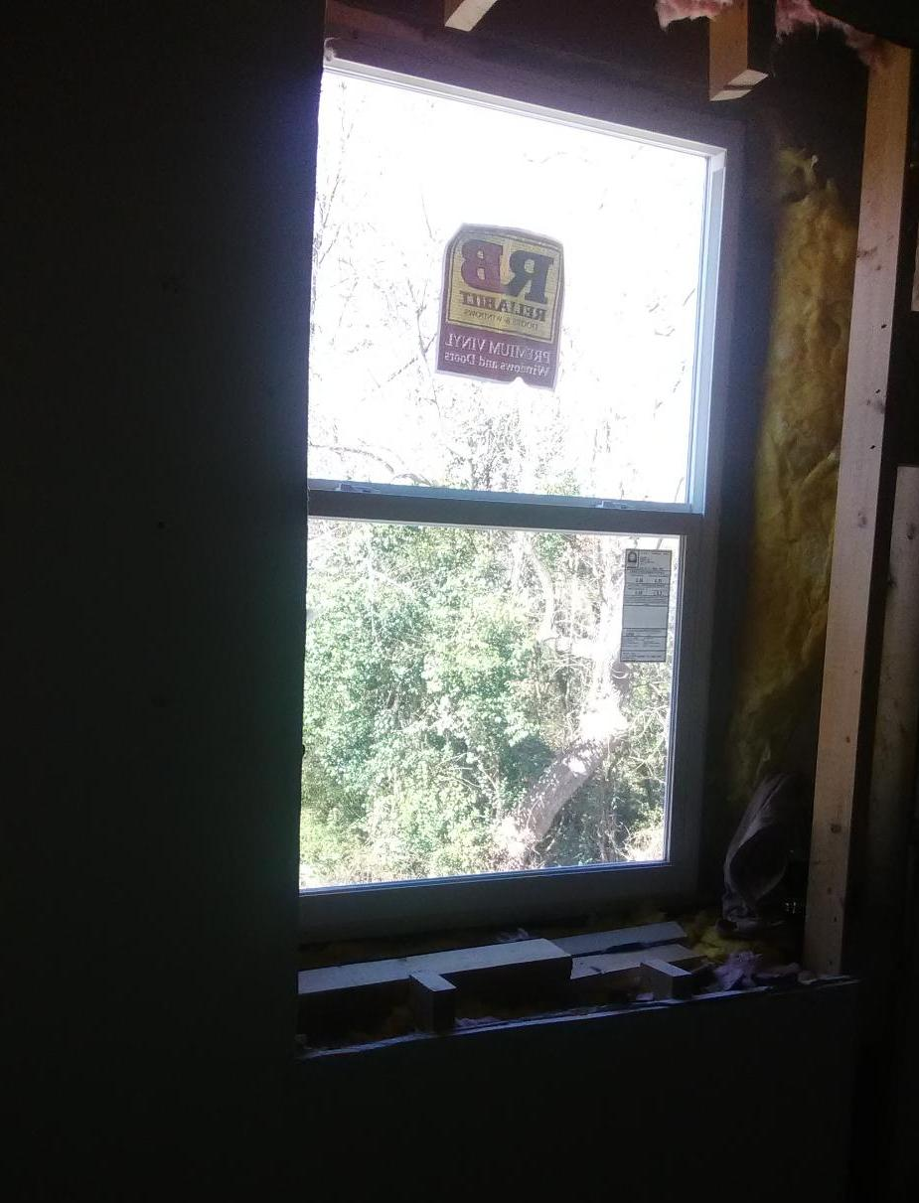
Thank you for the donation of the windows and for the individuals who worked tirelessly to install them. This was not an easy task!

Slide 39
Homer & Kathy Pike

Slide 40
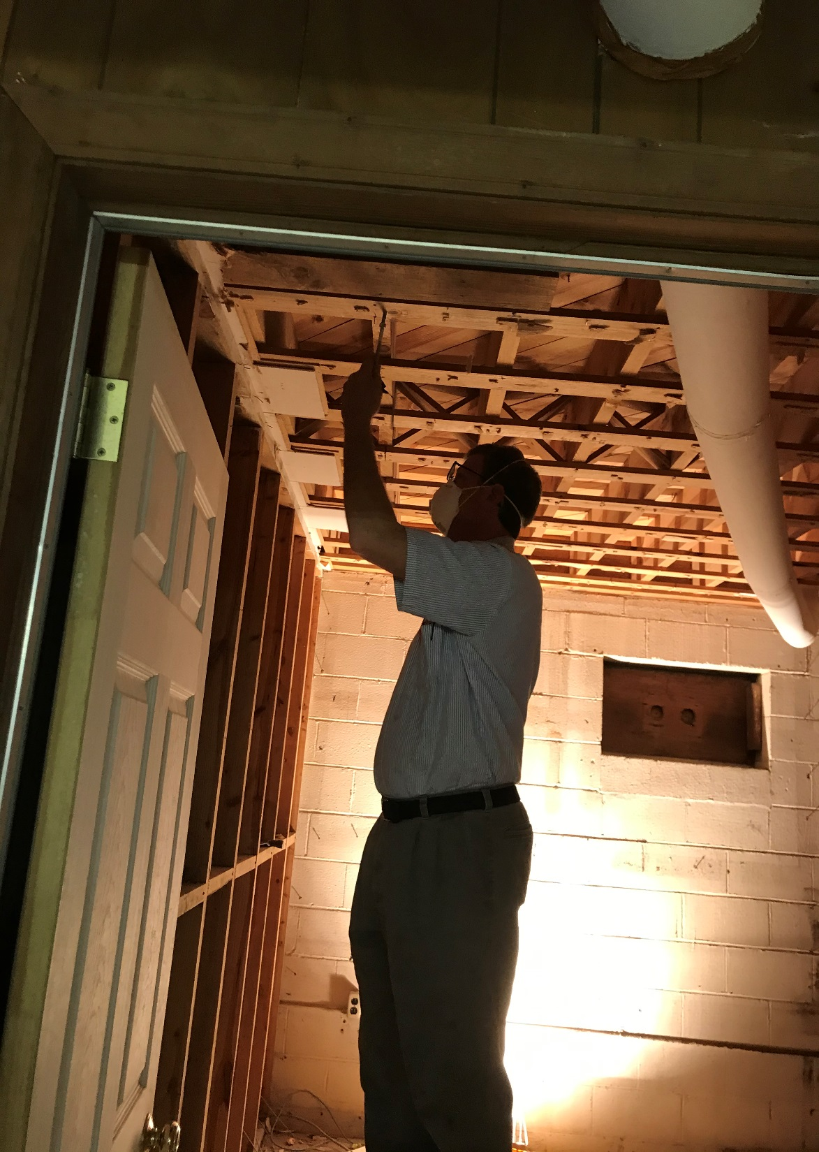
Thank you to the electricians that rewired and put in new wiring for the kitchen and all the other rooms. Especially when they had to work by spotlight.
God Bless You Guys!

Slide 41
Pleasant Hill Christian

Slide 42
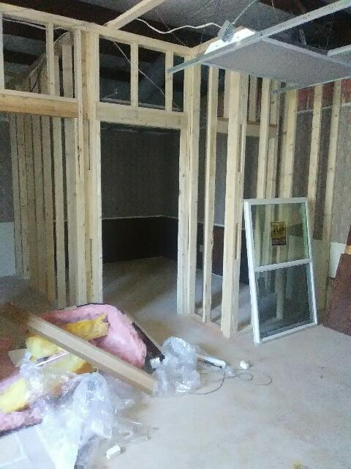
Thank you to all the carpenters both young and old who helped in framing out all the apartment rooms, Kitchen, and bathrooms.
You are our hero's.

Slide 43
Rep. Dennis Riddell

Slide 44
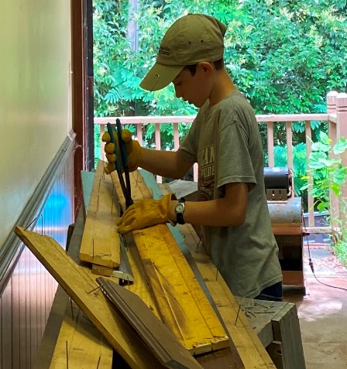
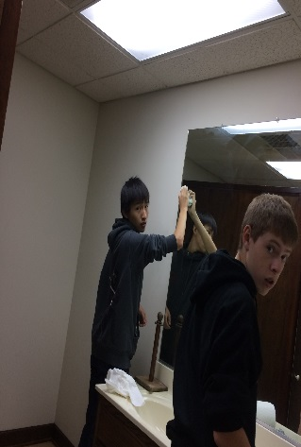
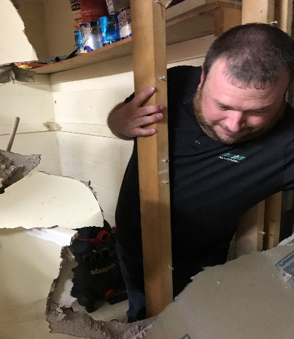
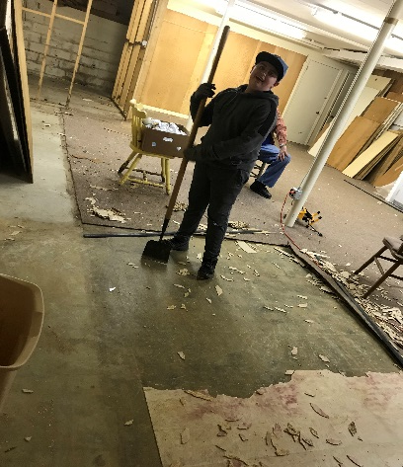
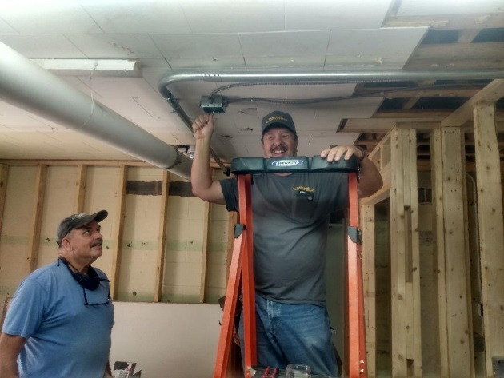
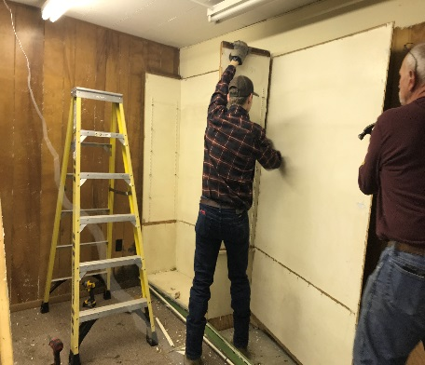
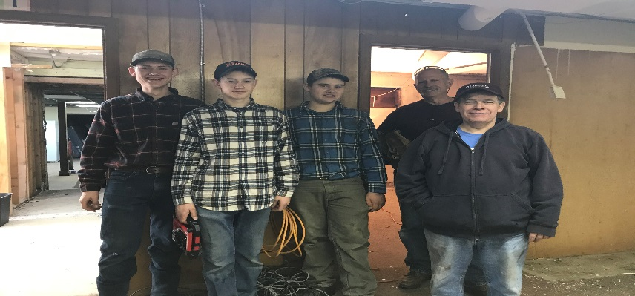
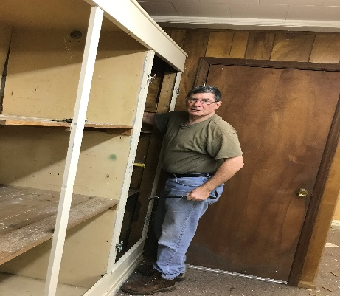
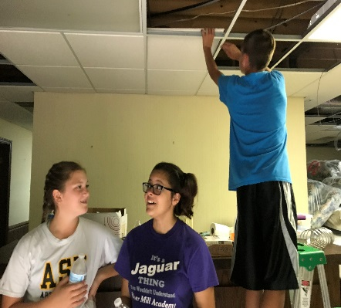
Only a few of the faces of the many volunteers that have helped us progress on the Women and Children’s Shelter. We could not do this work without our supporters and volunteers. We pray each of you will be blessed by God for all you have done to help. We look forward to seeing more of you at the shelter with the sheet rock, painting, flooring, and much more work…..coming up in the near future.

Slide 45
Riverside Baptist Church

Slide 46
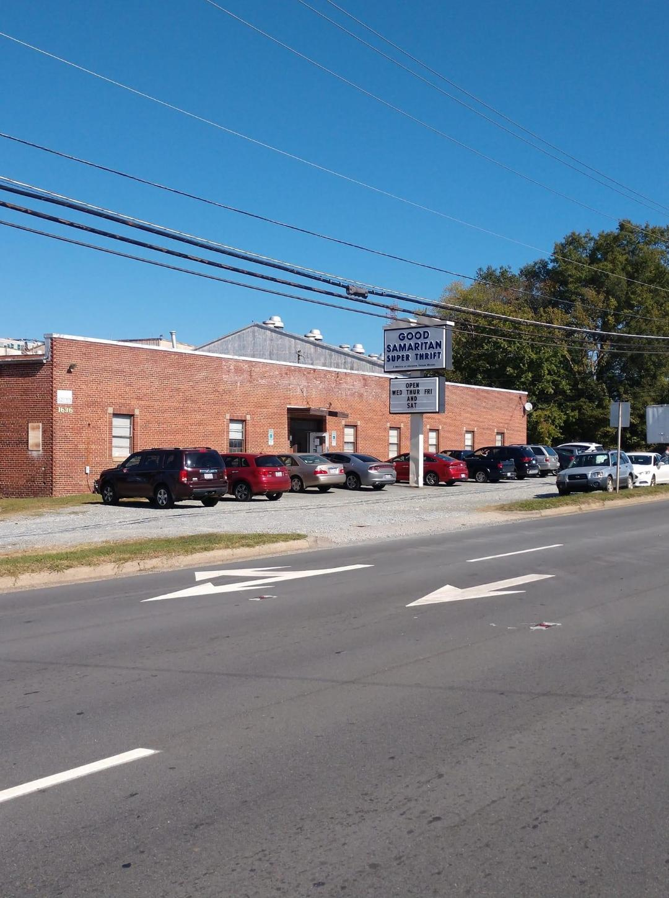
Good Samaritan Super Thrift Store
GSST gives PRM a place for the men at the mission to work while on restriction.
GSST also serves the needy in our community who may need clothes or furniture for their homes.

Slide 47
James & Mary Robinson

Slide 48
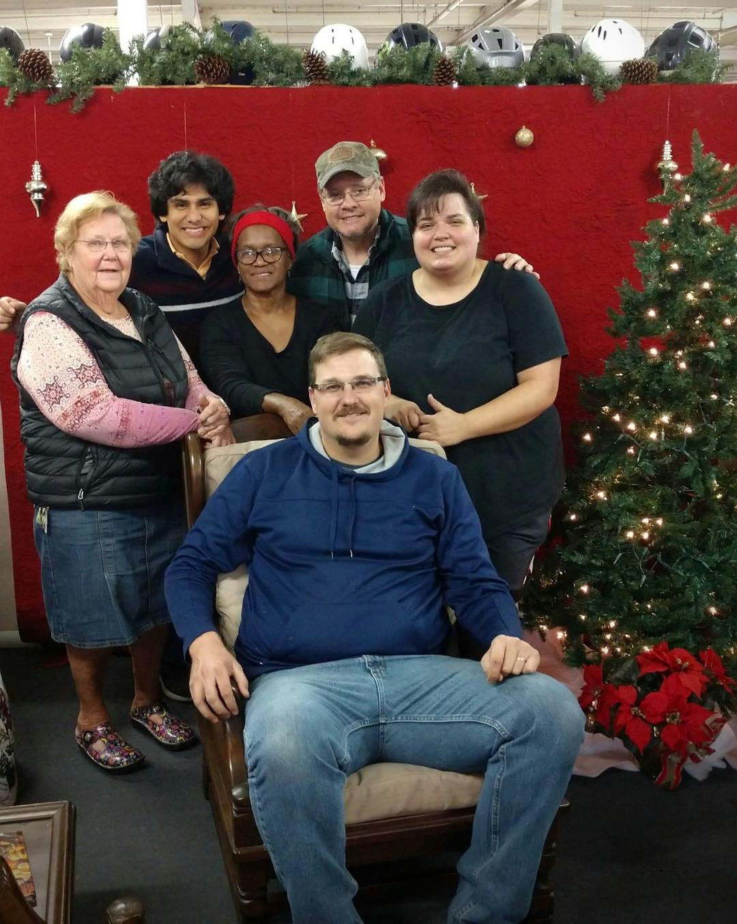
Meet the Staff of
Good Samaritan Super
Thrift Store
Brandon Gibson Director
Steve Sykes Manager
Manuel Pitman Supervisor
Barbara Gregory Cashier
Marie Ore Cashier
Teresa Blackwell Cashier

Slide 49
L.J. Rogers Jr. Trucking

Slide 50
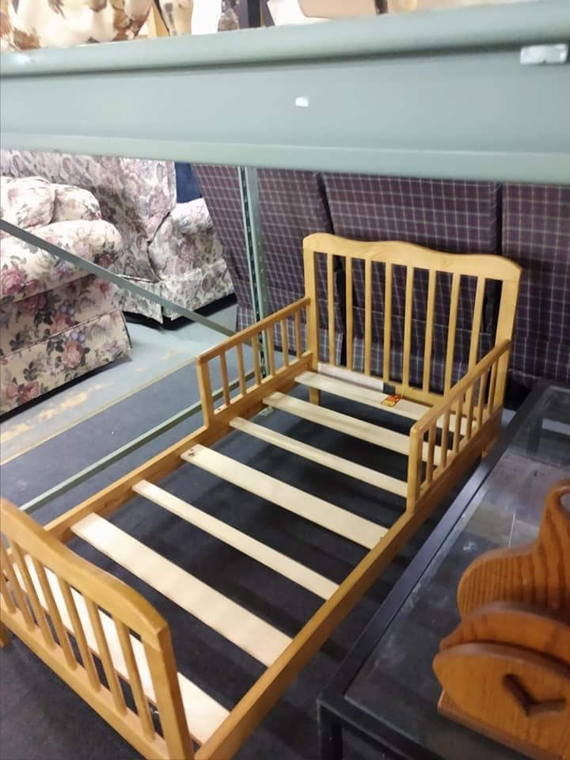
Good Samaritan has a variety of household furniture in stock at all times thanks to people that donate to us.

Slide 51
Salem Presbyterian Church

Slide 52
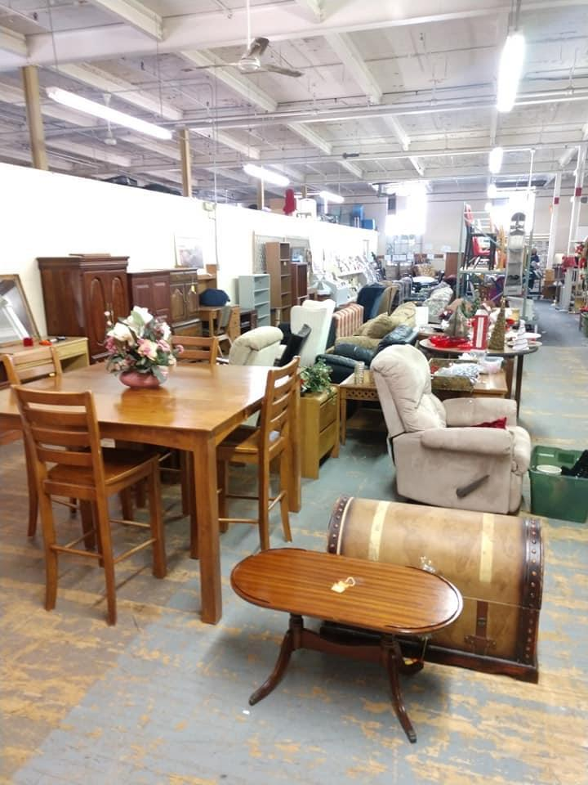
Chairs, End Tables, Couches,
Dining Room Tables, Bookshelves,
T.V. Stands and much more….

Slide 53
David & Lucy Scott

Slide 54
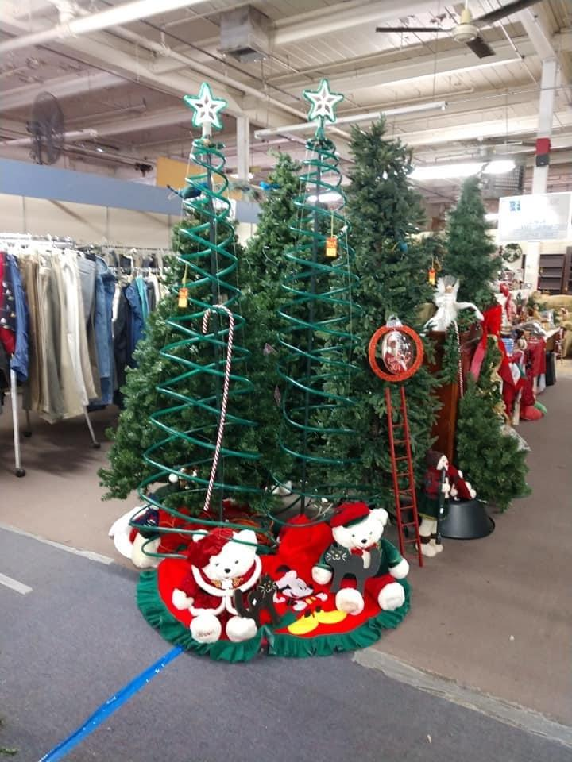
Christmas Trees of all shapes and sizes. Lights and ornaments for the trees.
Christmas decorations for the yard, Wreaths and much more…

Slide 55
Rodney & Tommie Smith

Slide 56
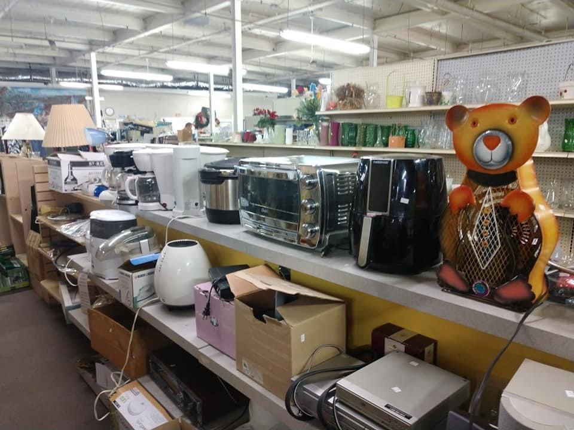
Small Kitchen Appliances
Toasters,
Toaster Ovens, Mixers, Blenders, Crock Pots, Electric can openers,
Coffee pots and much more…

Slide 57
Spring Lake Baptist Church

Slide 58
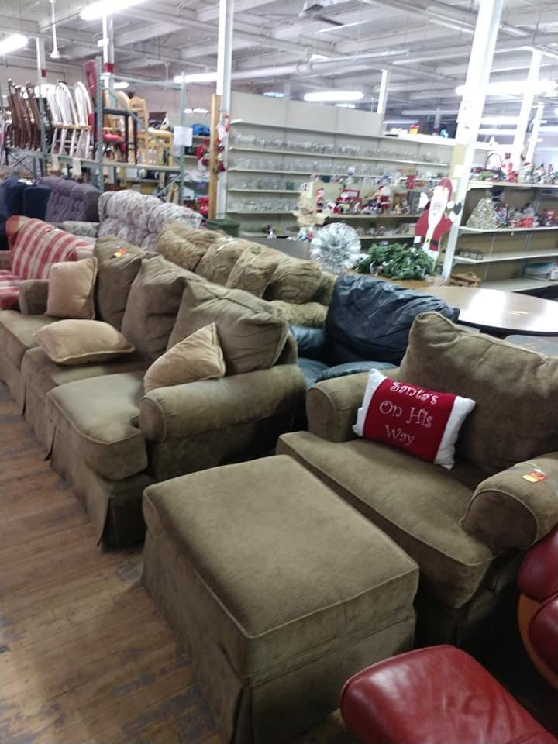
Living Room Furniture
Overstuffed Chairs, Sofas of all sizes. Lamps, Televisions,
Nic Nacs
You name it
Good Samaritan has it or has had it at some time.

Slide 59
Stonewall Construction LLC

Slide 60
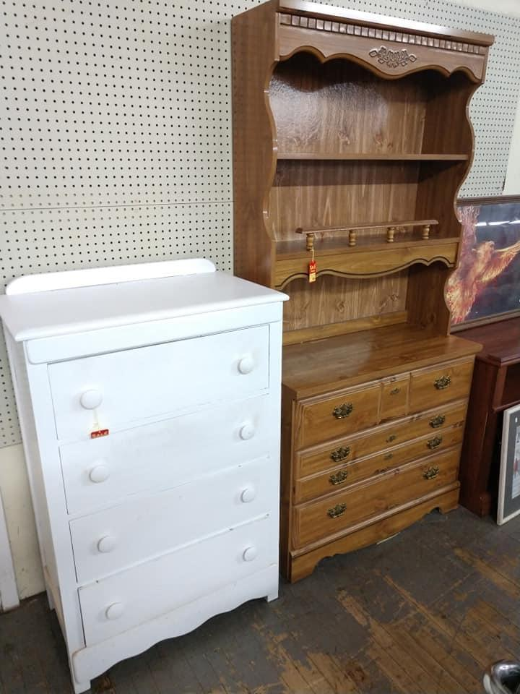
These nice items are donated to Good Samaritan for us to sell to help support the ministries of
Piedmont Rescue Mission:
Alamance Rescue Mission
Alamance Pregnancy Services
PRM Women & Children’s Shelter

Slide 61
Tabernacle Baptist Church

Slide 62
We would like to give a great big shout out to all our volunteers from so many different churches. Youth groups, school groups, men’s groups and women’s groups who have been so faithful to donate their time over the last year
to help us in the work here
in all our ministries.

Slide 63
David & Robin Tate

Slide 64
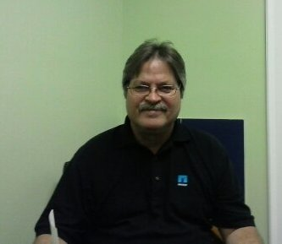
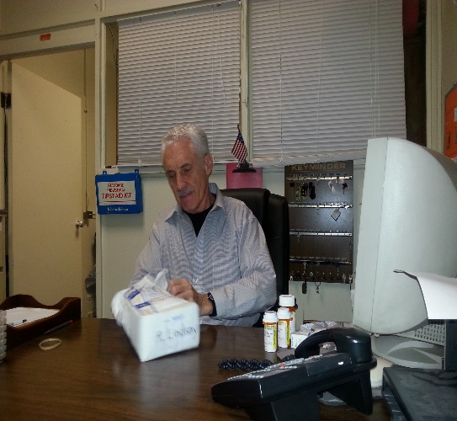
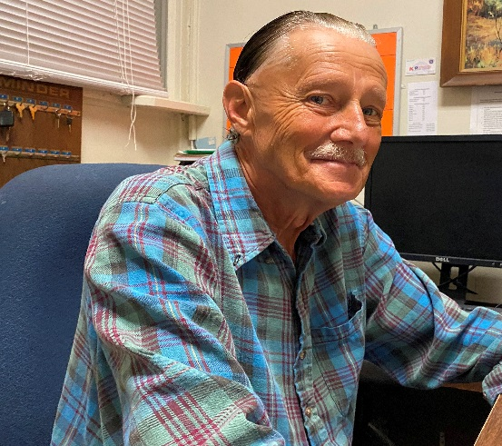
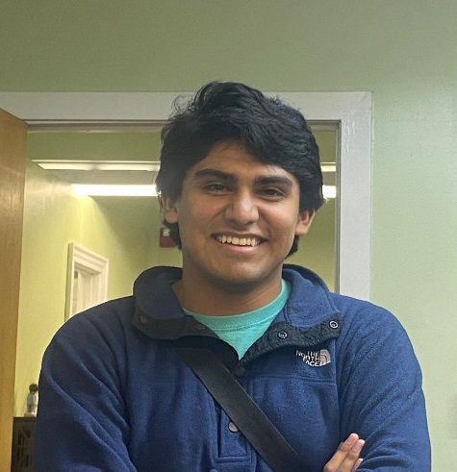
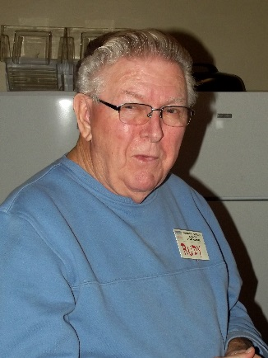
Alamance Rescue Mission Staff
George Kreigh
Kent Garner
Howard Hale
Manuel Pitman
Food Distribution Staff
Administrative Office
Rudy& Judy Stevens
Resident Staff
Bill Weeks
Jonathan
Tammy Speicher
Jerome

Slide 65
Billy & Jean Todd

Slide 67
Trinity Baptist Church

Slide 68
Parents and Children
Working together as volunteers is such a sweet sight to see. What a way to teach children how to give back.

Slide 69
Trinity Worship Center

Slide 70
We wish each one of you
A Merry Christmas
and
A Happy New Year
Thank you for taking time out of your busy schedules to spend an evening with Piedmont Rescue Mission
God Bless You All!

Slide 71
Wrightenberry Hosiery

Slide 72
The Ministries of Piedmont Rescue Mission would like to thank you for attending the banquet tonight. We would like to thank all the table sponsors who helped make this night possible for us.

